Slide 1


Epithelial Tissue
Dr. Mahdi H. Hammadi
PhD Sc. Clinical Physiology

Slide 2
Epithelial Tissue
Epithelial tissue is a sheet of cells that covers a body surface or lines a body cavity. Two forms occur in the human body:
Covering and lining epithelium– forms the outer layer of the skin; lines open cavities of the digestive and respiratory systems; covers the walls of organs of the closed ventral body cavity.
Glandular epithelium– surrounds glands within the body.

Slide 3
Characteristics of epithelium
Epithelial tissues have five main characteristics

Slide 4
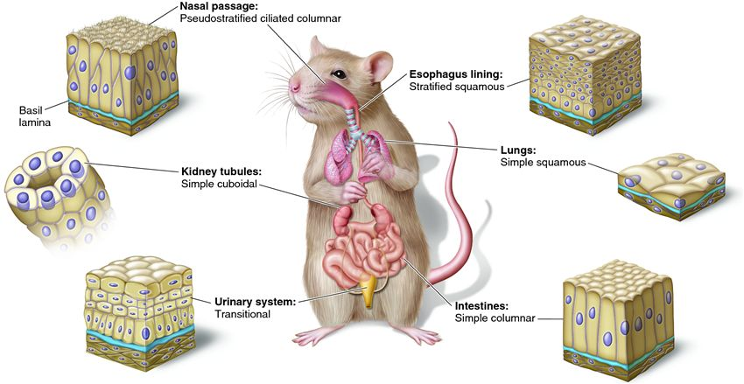
Polarity

Slide 5
Specialized contacts– epithelial cells fit close together and form continuous sheets (except in the case of glandular epithelia). They do this with tight junctions and desmosomes. Tight junctions form the closest contact between cells and help keep proteins in the apical region of the plasma membrane. Desmosomes connect the plasma membrane to intermediate filaments in the cytoplasm.
Supported by connective tissue– all epithelia are supported by connective tissue. For instance, deep to the basal lamina is

Slide 6
Avascular and innervated– even though epithelium is avascular (contains no blood vessels), it’s still innervated (supplied by nerve fibers).
Regeneration– epithelium have a high regenerative capacity and can reproduce rapidly as long as they receive adequate nutrition.

Slide 7
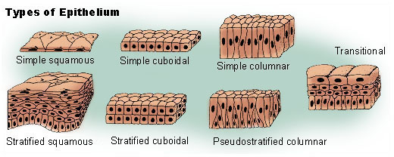
Classification of Epithelia

Slide 8
Epithelium has two names. The first name indicates the number of cell layers, the second describes the shape of its cell. Based on the number of cell layers, epithelia can either be simple or stratified.
Simple epithelia– consist of a single cell layer (found where absorption, secretion, and filtration occur).
Stratified epithelia– are composed of two or more cell layers stacked on top of each other (typically found in high abrasion areas where protection is needed

Slide 9
All epithelial cells have six sides but they vary in height. For this reason, there are three ways to describe the shape and height of epithelial cells.
Squamous cells– are flat and scale-like.
Cuboidal cells– are box-like (same height and width).
Columnar cells– are tall (column shaped).
Simple squamous epithelium

Slide 10
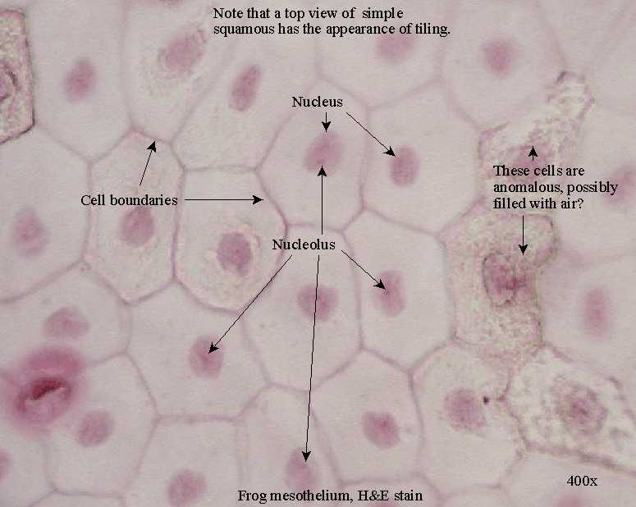

Slide 11
Simple squamous epithelium– are close fitting and flattened laterally. They’re found where filtration occurs (kidneys, lungs) and they resemble the look of a fried egg. Two simple squamous epithelia in the body have special names reflecting their location.

Slide 12
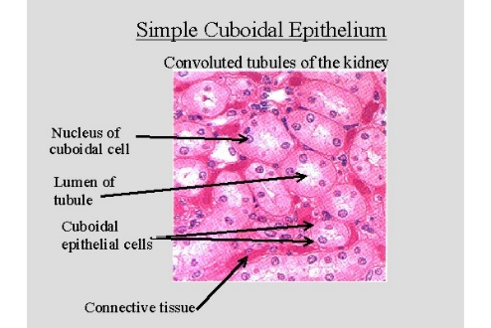

Slide 13
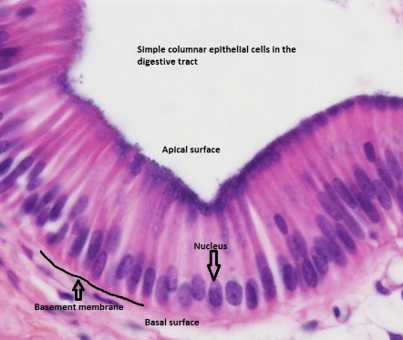
Simple columnar epithelium

Slide 14
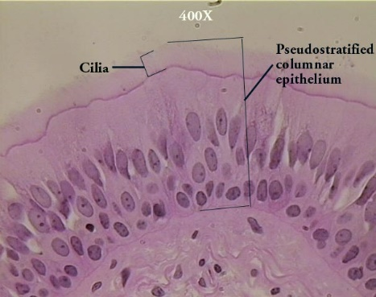
Pseudostratified columnar

Slide 15
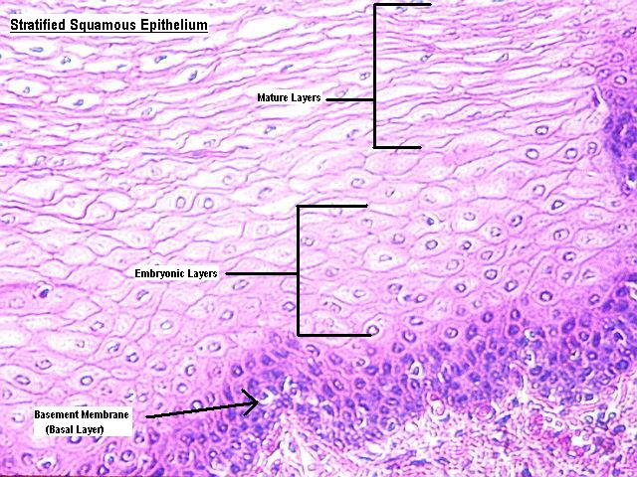

Slide 16
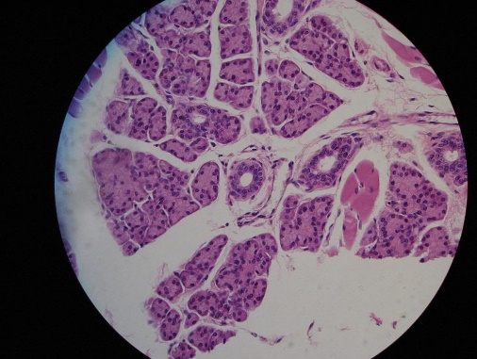
Stratified cuboidal epithelium

Slide 17
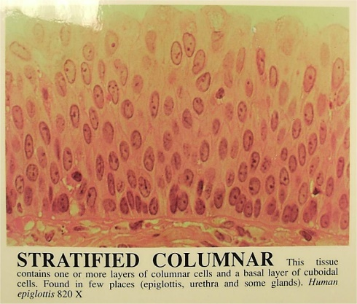
Stratified columnar epithelium

Slide 18
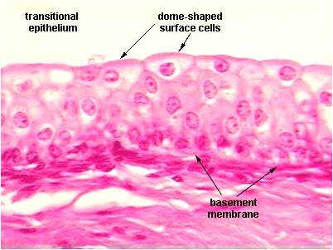
Transitional epithelium

